Slide 1
Technological Examples Virtualization
Prepared by
AVITA KATAL
Assistant professor
Department of Virtualization
SCS,UPES

Slide 2
Contents
Xen: ParaVirtualization
Vmware: Full Virtualization
Microsoft HyperV: Infrastructure Virtualization

Slide 3
1. Xen :ParaVirtualization
Xen is an open-source initiative implementing a virtualization platform based on paravirtualization.
Initially developed by a group of researchers at the University of Cambridge in the United Kingdom, Xen now has a large open-source community backing it. Citrix also offers it as a commercial solution, XenSource.
Xen-based technology is used for either desktop virtualization or server virtualization, and recently it has also been used to provide cloud computing solutions by means of Xen Cloud Platform (XCP).
At the basis of all these solutions is the Xen Hypervisor, which constitutes the core technology of Xen.
Recently, Xen has been advanced to support full virtualization using hardware-assisted virtualization.
Xen is the most popular implementation of paravirtualization, which, in contrast with full virtualization, allows high-performance execution of guest operating systems.
This is made possible by eliminating the performance loss while executing instructions that require special management. This is done by modifying portions of the guest operating systems run by Xen with reference to the execution of such instructions.

Slide 4
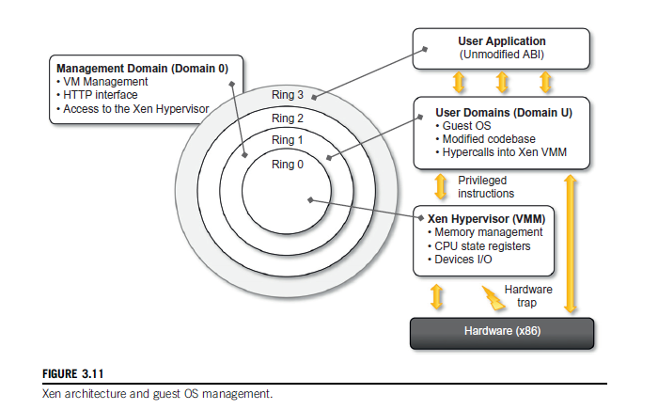
1. Xen :ParaVirtualization contd…

Slide 5
1. Xen :ParaVirtualization contd…
A Xen-based system is managed by the Xen hypervisor, which runs in the highest privileged mode and controls the access of guest operating system to the underlying hardware.
Guest operating systems are executed within domains, which represent virtual machine instances.
Moreover, specific control software, which has privileged access to the host and controls all the other guest operating systems, is executed in a special domain called Domain 0.This is the first one that is loaded once the virtual machine manager has completely booted, and it hosts a HyperText Transfer Protocol (HTTP) server that serves requests for virtual machine creation, configuration, and termination.
This component constitutes the embryonic version of a distributed virtual machine manager, which is an essential component of cloud computing systems providing Infrastructure-as-a-Service (IaaS) solutions.

Slide 6
1. Xen :ParaVirtualization contd…
Many of the x86 implementations support four different security levels, called rings, where Ring 0 represent the level with the highest privileges and Ring 3 the level with the lowest ones.
Almost all the most popular operating systems, except OS/2, utilize only two levels: Ring 0 for the kernel code, and Ring 3 for user application and non privileged OS code.
This provides the opportunity for Xen to implement virtualization by executing the hypervisor in Ring 0, Domain 0, and all the other domains running guest operating systems—generally referred to as Domain U—in Ring 1, while the user applications are run in Ring 3.
This allows Xen to maintain the ABI unchanged, thus allowing an easy switch to Xen virtualized solutions from an application point of view.

Slide 7
1. Xen :ParaVirtualization contd…
Because of the structure of the x86 instruction set, some instructions allow code executing in Ring 3 to jump into Ring 0 (kernel mode). Such operation is performed at the hardware level and therefore within a virtualized environment will result in a trap or silent fault, thus preventing the normal operations of the guest operating system, since this is now running in Ring 1. This condition is generally triggered by a subset of the system calls.
To avoid this situation, operating systems need to be changed in their implementation, and the sensitive system calls need to be re-implemented with hypercalls, which are specific calls exposed by the virtual machine interface of Xen.
With the use of hypercalls, the Xen hypervisor is able to catch the execution of all the sensitive instructions, manage them, and return the control to the guest operating system by means of a supplied handler.

Slide 8
1. Xen :ParaVirtualization contd…
Paravirtualization needs the operating system codebase to be modified, and hence not all operating systems can be used as guests in a Xen-based environment.
More precisely, this condition holds in a scenario where it is not possible to leverage hardware-assisted virtualization, which allows running the hypervisor in Ring -1 and the guest operating system in Ring 0. Therefore, Xen exhibits some limitations in the case of legacy hardware and legacy operating systems.
In fact, these cannot be modified to be run in Ring 1 safely since their codebase is not accessible and, at the same time, the underlying hardware does not provide any support to run the hypervisor in a more privileged mode than Ring 0.
Open-source operating systems such as Linux can be easily modified, since their code is publicly available and Xen provides full support for their virtualization, whereas compo-nents of the Windows family are generally not supported by Xen unless hardware-assisted virtualization is available.
It can be observed that the problem is now becoming less and less crucial since both new releases of operating systems are designed to be virtualization aware and the new hardware supports x86 virtualization.

Slide 9
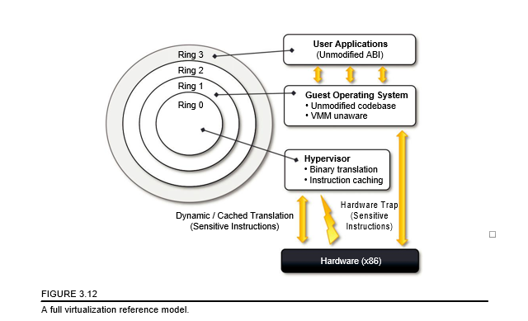
2. Vmware: Full Virtualization
Notes:
3.6.2.1 Full virtualization and binary translation
VMware is well known for the capability to virtualize x86 architectures, which runs unmodified on top of their hypervisors. With the new generation of hardware architectures and the introduction of hardware-assisted virtualization (Intel VT-x and AMD V) in 2006, full virtualization is made pos-sible with hardware support, but before that date, the use of dynamic binary translation was the only solution that allowed running x86 guest operating systems unmodified in a virtualized environment.
As discussed before, x86 architecture design does not satisfy the first theorem of virtualization, since the set of sensitive instructions is not a subset of the privileged instructions. This causes a dif-ferent behavior when such instructions are not executed in Ring 0, which is the normal case in a virtualization scenario where the guest OS is run in Ring 1. Generally, a trap is generated and the way it is managed differentiates the solutions in which virtualization is implemented for x86 hard-ware. In the case of dynamic binary translation, the trap triggers the translation of the offending instructions into an equivalent set of instructions that achieves the same goal without generating exceptions. Moreover, to improve performance, the equivalent set of instruction is cached so that translation is no longer necessary for further occurrences of the same instructions. Figure 3.12 gives an idea of the process.
This approach has both advantages and disadvantages. The major advantage is that guests can run unmodified in a virtualized environment, which is a crucial feature for operating systems for which source code is not available. This is the case, for example, of operating systems in the Windows family. Binary translation is a more portable solution for full virtualization. On the other hand, translating instructions at runtime introduces an additional overhead that is not present in other approaches (paravirtualization or hardware-assisted virtualization). Even though such disad-vantage exists, binary translation is applied to only a subset of the instruction set, whereas the others are managed through direct execution on the underlying hardware. This somehow reduces the impact on performance of binary translation.
CPU virtualization is only a component of a fully virtualized hardware environment. VMware achieves full virtualization by providing virtual representation of memory and I/O devices. Memory virtualization constitutes another challenge of virtualized environments and can deeply impact per-formance without the appropriate hardware support. The main reason is the presence of a memory management unit (MMU), which needs to be emulated as part of the virtual hardware. Especially in the case of hosted hypervisors (Type II), where the virtual MMU and the host-OS MMU are tra-versed sequentially before getting to the physical memory page, the impact on performance can be significant. To avoid nested translation, the translation look-aside buffer (TLB) in the virtual MMU directly maps physical pages, and the performance slowdown only occurs in case of a TLB miss

Slide 10
2. Vmware: Full Virtualization contd…
VMware’s technology is based on the concept of full virtualization, where the underlying hardware is replicated and made available to the guest operating system, which runs unaware of such abstraction layers and does not need to be modified.
VMware implements full virtualization either in the desktop environment, by means of Type II hypervisors, or in the server environment, by means of Type I hypervisors.
In both cases, full virtualization is made possible by means of direct execution for non sensitive instructions and binary translation for sensitive instructions, thus allowing the virtualization of architecture such as x86.

Slide 11
2. Vmware: Full Virtualization contd…
VMware is well known for the capability to virtualize x86 architectures, which runs unmodified on top of their hypervisors.
With the new generation of hardware architectures and the introduction of hardware-assisted virtualization (Intel VT-x and AMD V) in 2006, full virtualization is made possible with hardware support, but before that date, the use of dynamic binary translation was the only solution that allowed running x86 guest operating systems unmodified in a virtualized environment.
x86 architecture design does not satisfy the first theorem of virtualization, since the set of sensitive instructions is not a subset of the privileged instructions. This causes a different behaviour when such instructions are not executed in Ring 0, which is the normal case in a virtualization scenario where the guest OS is run in Ring 1.
Generally, a trap is generated and the way it is managed differentiates the solutions in which virtualization is implemented for x86 hardware.

Slide 12
2. Vmware: Full Virtualization contd…
In the case of dynamic binary translation, the trap triggers the translation of the offending instructions into an equivalent set of instructions that achieves the same goal without generating exceptions.
Moreover, to improve performance, the equivalent set of instruction is cached so that translation is no longer necessary for further occurrences of the same instructions.
This approach has both advantages and disadvantages:
The major advantage is that guests can run unmodified in a virtualized environment, which is a crucial feature for operating systems for which source code is not available. This is the case, for example, of operating systems in the Windows family. Binary translation is a more portable solution for full virtualization.
On the other hand, translating instructions at runtime introduces an additional overhead that is not present in other approaches (paravirtualization or hardware-assisted virtualization).
Even though such disadvantage exists, binary translation is applied to only a subset of the instruction set, whereas the others are managed through direct execution on the underlying hardware. This somehow reduces the impact on performance of binary translation.

Slide 13
2. Vmware: Full Virtualization contd…
CPU virtualization is only a component of a fully virtualized hardware environment.
VMware achieves full virtualization by providing virtual representation of memory and I/O devices.
Memory virtualization constitutes another challenge of virtualized environments and can deeply impact performance without the appropriate hardware support.
The main reason is the presence of a memory management unit (MMU), which needs to be emulated as part of the virtual hardware.
Especially in the case of hosted hypervisors (Type II), where the virtual MMU and the host-OS MMU are traversed sequentially before getting to the physical memory page, the impact on performance can be significant.
To avoid nested translation, the translation look-aside buffer (TLB) in the virtual MMU directly maps physical pages, and the performance slowdown only occurs in case of a TLB miss.

Slide 14
3. Microsoft Hyper-V
Hyper-V is an infrastructure virtualization solution developed by Microsoft for server virtualization.
As the name recalls, it uses a hypervisor-based approach to hardware virtualization, which leverages several techniques to support a variety of guest operating systems.
Hyper-V is currently shipped as a component of Windows Server 2008 R2 that installs the hypervisor as a role within the server.
Hyper-V supports multiple and concurrent execution of guest operating systems by means of partitions.
A partition is a completely isolated environment in which an operating system is installed and run.
Despite its straightforward installation as a component of the host operating system, Hyper-V takes control of the hardware, and the host operating system becomes a virtual machine instance with special privileges, called parent partition.

Slide 15
3. Microsoft Hyper-V contd…
The parent partition (also called the root partition) is the only one that has direct access to the hardware.
It runs the virtualization stack, hosts all the drivers required to configure guest operating systems, and creates child partitions through the hypervisor.
Child partitions are used to host guest operating systems and do not have access to the underlying hardware, but their interaction with it is controlled by either the parent partition or the hypervisor itself.
The hypervisor is the component that directly manages the underlying hardware (processors and memory). It is logically defined by the following components:
Hypercalls interface: This is the entry point for all the partitions for the execution of sensitive instructions. This is an implementation of the para virtualization approach already discussed with Xen. The parent partition also uses this interface to create child partitions.
Memory service routines (MSRs): These are the set of functionalities that control the memory and its access from partitions.
Advanced programmable interrupt controller (APIC): This component represents the interrupt controller, which manages the signals coming from the underlying hardware when some event occurs (timer expired, I/O ready, exceptions and traps).
Notes:
Hypervisor
Enlightened I/O and synthetic devices
Enlightened I/O provides an optimized way to perform I/O operations, allowing guest operating systems to leverage an interpartition communication channel rather than traversing the hardware emulation stack provided by the hypervisor. This option is only available to guest operating sys-tems that are hypervisor aware. Enlightened I/O leverages VMBus, an interpartition communication
3.6 Technology examples 107
channel that is used to exchange data between partitions (child and parent) and is utilized mostly for the implementation of virtual device drivers for guest operating systems.
The architecture of Enlightened I/O is described in Figure 3.17. There are three fundamental components: VMBus, Virtual Service Providers (VSPs), and Virtual Service Clients (VSCs). VMBus implements the channel and defines the protocol for communication between partitions. VSPs are kernel-level drivers that are deployed in the parent partition and provide access to the corresponding hardware devices. These interact with VSCs, which represent the virtual device drivers (also called synthetic drivers) seen by the guest operating systems in the child partitions. Operating systems supported by Hyper-V utilize this preferred communication channel to perform I/O for storage, networking, graphics, and input subsystems. This also results in enhanced perfor-mance in child-to-child I/O as a result of virtual networks between guest operating systems. Legacy operating systems, which are not hypervisor aware, can still be run by Hyper-V but rely on device driver emulation, which is managed by the hypervisor and is less efficient.
Parent partition
The parent partition executes the host operating system and implements the virtualization stack that complements the activity of the hypervisor in running guest operating systems. This partition always hosts an instance of the Windows Server 2008 R2, which manages the virtualization stack made available to the child partitions. This partition is the only one that directly accesses device drivers and mediates the access to them by child partitions by hosting the VSPs.
The parent partition is also the one that manages the creation, execution, and destruction of child partitions. It does so by means of the Virtualization Infrastructure Driver (VID), which con-trols access to the hypervisor and allows the management of virtual processors and memory. For each child partition created, a Virtual Machine Worker Process (VMWP) is instantiated in the par-ent partition, which manages the child partitions by interacting with the hypervisor through the VID. Virtual Machine Management services are also accessible remotely through a WMI⁹ provider that allows remote hosts to access the VID.
Child partitions
Child partitions are used to execute guest operating systems. These are isolated environments that allow secure and controlled execution of guests. Two types of child partition exist, they differ on whether the guest operating system is supported by Hyper-V or not. These are called Enlightened and Unenlightened partitions, respectively. The first ones can benefit from Enlightened I/O; the other ones are executed by leveraging hardware emulation from the hypervisor.

Slide 16
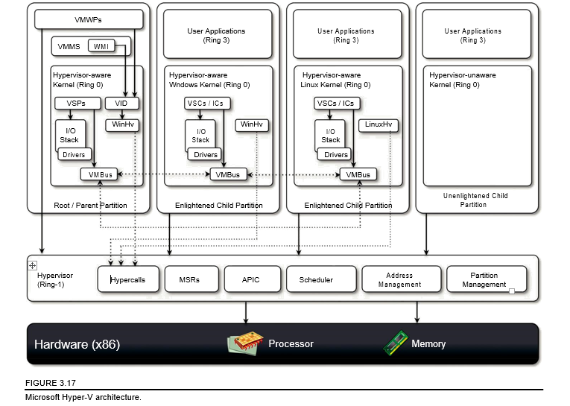
3. Microsoft Hyper-V contd…

Slide 17
3. Microsoft Hyper-V contd…
Scheduler: This component schedules the virtual processors to run on available physical processors. The scheduling is controlled by policies that are set by the parent partition.
Address manager: This component is used to manage the virtual network addresses that are allocated to each guest operating system.
Partition manager: This component is in charge of performing partition creation, finalization, destruction, enumeration, and configurations. Its services are available through the hypercalls interface API previously discussed.
The hypervisor runs in Ring -1 and therefore requires corresponding hardware technology that enables such a condition. By executing in this highly privileged mode, the hypervisor can support legacy operating systems that have been designed for x86 hardware.

